Slide 1
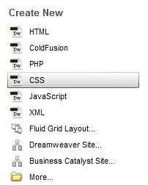
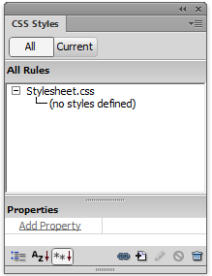
Web Authoring (Ski Resort Task)
Task 1 – Create CSS Style Sheet
Create a new Root Folder called Ski Holiday Create a new a CSS and save it into the root folder as stylesheet. Use the CSS Window to create the styles listed below. Body Tag You would use this tag normally to format your background (Image or Colour) You can set your table styles using the Table and TD Tags. TD – is used for the internal settings for the table.
H1 - #FFFFFF, San-Serif, 12, bold, center H2 – #ff0000, serif, 14, left, bold H3 – #800000 Red – no blue or green component, serif, 14 H4 – #008000Green – No red or blue, serif, 16, center H5 – #000060, San-Serif, 16, left, bold P - #000000, San-Serif, 12 LI – #600000, serif, 14, left, italic, disc Body – background colour – Backgroundimage.jpg (as tiled) Table - Set background colour to grey, Set border to yellow (width 3) Collapse Border TD - Set border colour to red (width 2) Set your name as a comment

